Slide 1
Micro-credentials and universities: Big opportunities for small volumes of learning
Magalie Soenen
Flemish Ministry of Education and Training – MICROBOL project
-
5 July 2021

Slide 2
European Framework (EU-level)

Slide 3
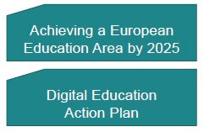
European Framework (EU-level)

Slide 4
European Framework: Skills Agenda
The new initiative will support the quality, transparency and use of micro-credentials throughout the EU;
The Commission will work with all stakeholders to develop European standards of quality and transparency;
Explore the inclusion of micro-credentials in qualification frameworks;
Inclusion in Europass (Europass Digital Credentials Initiative)

Slide 5
European Framework: European Education Area
Focus on HE, re-skilling and upskilling;
Higher Education Consultation Group on Micro-credentials at the level of DG EAC
Commission preparing Council recommendations to be published in December 2021 => consultation currently open
European actions should support European trust in micro-credentials
Member States should strive to take all necessary steps for a wider use, portability and recognition of these micro-credentials by 2025

Slide 6
European Framework: Higher Education Consultation Group on MC’s

Slide 7
European Framework: Higher Education Consultation Group on MC’s
aim: develop a proposal for a common definition and recommendations for a European approach to micro-credentials in Europe
final report presented on 14 December 2020 “A European approach to micro-credentials - output of the micro-credentials higher education consultation group”

Slide 8
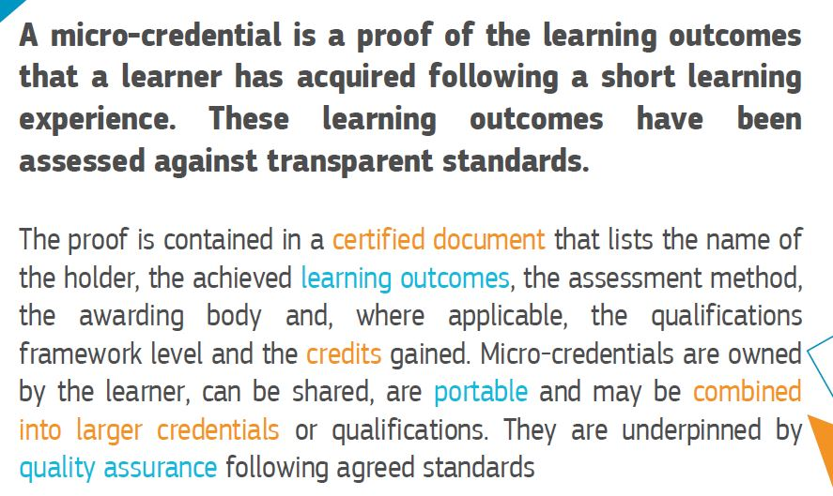
European Framework: Higher Education Consultation Group on MC’s
Definition

Slide 9
European Framework: Higher Education Consultation Group on MC’s
Proposed EU Standard of constitutive elements of micro-credentials

Slide 10
European Framework: Higher Education Consultation Group on MC’s
A common and transparent DEFINITION and an EU STANDARD for micro-credentials
Alignment to the national and European QUALIFICATIONS FRAMEWORKS (*)
QUALITY ASSURANCE standards for short learning courses – guidelines (*)
European Credit Transfer and Accumulation System (ECTS) – adaption Users’ Guide (*)
RECOGNITION – role ENIC/NARICs(*)
STORAGE and PORTABILITY
NATIONAL LEVEL ACTIONS – Consultation phase
LIFELONG LEARNING (“Ensuring better permeability between education and training sectors”)
UPTAKE by higher education institutions, VET and other education and training institutions
(*) Explicit link with MICROBOL

Slide 11
European Framework: EHEA
The MICROBOL project

Slide 12
Details
Title: Micro-credentials linked to the Bologna Key Commitments
Erasmus+ KA3: Initiatives to support the implementation of European Higher Education Area (EHEA) reforms, 2019
Period: March 2020 – March 2022
Website: www.microcredentials.eu –
Email: Microbolproject@gmail.com

Slide 13
Partners
Coordinator: Belgium/Flemish Community, Departement Education & Training
Finland – Ministry of Education and Culture
Italy – CIMEA
EUA (European University Assiocation)
ENQA (European Association for Quality Assurance in Higher Education)
Experts: Anthony F. Camilleri, Frederik De Decker, Ann Katherine Isaacs, George Ubachs, Peter Van der Hijden
Associated partner: EQAR (European Quality Assurance Register)

Slide 14
Aims
Create awareness among national governments
Encourage and guide national governments to put the topic of micro-credentials on their policy agenda
Check whether existing Bologna tools can be used for micro-credentials and, if necessary, make proposals for adjustments at European level
Give recommendations to check national legislations and adapt them where necessary
Create a European framework for micro-credentials and propose this to the ministers in the Bologna Process

Slide 15
Where are we?
Desk research: published 14 Sept 2020
Kick-off conference: Webinar (>150 deelnemers)
Working groups:
Quality Assurance
70 participants, 34 countries, 7 stakeholder organisations
Recognition
60 participants, 33 countries, 5 stakeholder organisations
Qualification Frameworks
60 participants, 32 countries, 7 stakeholder organisations
Survey among EHEA countries (Feb 2021)
Recommendations on QA, Recognition & QF&ECTS (June 2021)
European Framework for Micro-credentials (July-Dec 2021)
Final Conference (Jan 2022)

Slide 16
Working definition…
“A micro-credential is a small volume of learning certified by a credential. In the EHEA context, it can be offered by higher education institutions or recognised by them using recognition procedures in line with the Lisbon Recognition Convention or recognition of prior learning, where applicable. A micro-credential is designed to provide the learner with specific knowledge, skills or competences that respond to societal, personal, cultural or labour market needs. Micro-credentials have explicitly defined learning outcomes at a QF-EHEA/NQF level, an indication of associated workload in ECTS credits, assessment methods and criteria, and are subject to quality assurance in line with the ESG.”

Slide 17
Points of attention?
No consensus yet on a definition or standards
Lack of clarity causes confusion among learners and employers
Many countries in (continental) Europe have micro-credentials but do not (yet) have regulation or a funding mechanism
Balance needed between the development/promotion of MCs and their regulation
Need for a flexible framework and guidelines at international level
Use/extend/adapt existing structures and Bologna tools
Need for peer support and exchange of practices
Difficulty of stand-alone MCs and 'other' providers

Slide 18
Countries that offer or are developing micro-credentials
Offered: 21 countries
Being developed: 3 countries
Not offered/not being developed: 8 countries
Notes:
To what extent micro-credentials are already offered in the national context, and what are the trends of their development;
Role of Europaen univesities in development of MCs

Slide 19
Examples of micro-credentials offered/recognised by HEIs

Slide 20
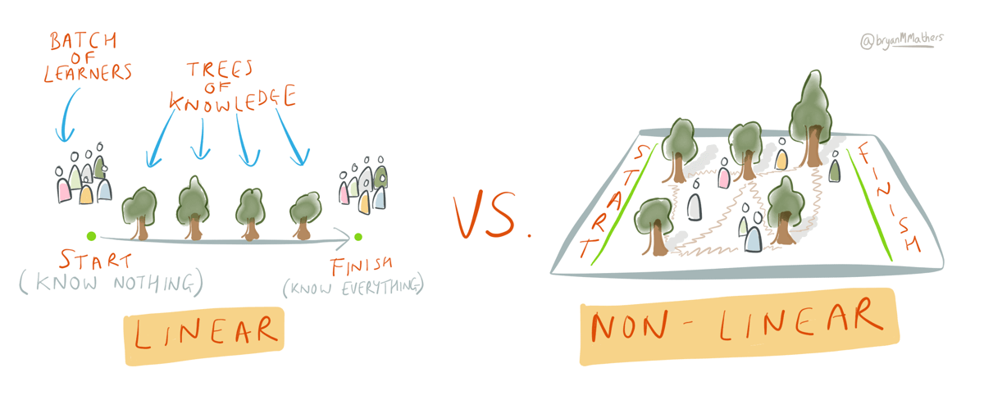
Why create micro-credentials?

Slide 21
Why create micro-credentials?
Changing context
New vision on education:
Less linear, more modular
Less time and place related
Links between
Different qualification levels
Different education providers
Formal, non-formal & informal learning

Slide 22
Situation in Belgium/Flemish Community
“Offered by higher education institutions”: Credit certificates
“Recognised by higher education institutions”:
Formal learning (HE) “Recognition of Prior Qualifications” (incl. these credit certificates) (“EVK”)
Non-formal/informal learning “Recognition of Prior Competences” (“EVC”)

Slide 23
Credit certificate (creditbewijs)
Definition (legal): an acknowledgement that, after an evaluation, a student has proven to master the competences* of a particular course unit. This acknowledgement is recorded in a document or is established by means of an electronic registration.
Use: exemption of parts of another study programme when shifting to another programme => RPL
* Remark: in the Flemish context competenc(i)es and learning outcomes are often used interchangeably…

Slide 24
Example Recognition of Prior Qualifications

Slide 25
Example Recognition of Prior Competences
Procedure of Ghent University Association (= univ. + 3 UAS)
Assessment of an applicant’s competences based on a portfolio + one or more of the following methods: reflection file, competence-based interview or capability test
Possible result:
“Certificate of Competency”
Can be used to get exemptions of courses (see above)

Slide 26
Possibilities of this legal framework
Creation of microdegrees
A number of courses -> successful completion = credit certificates
Bundled together as ‘microdegree’

Slide 27
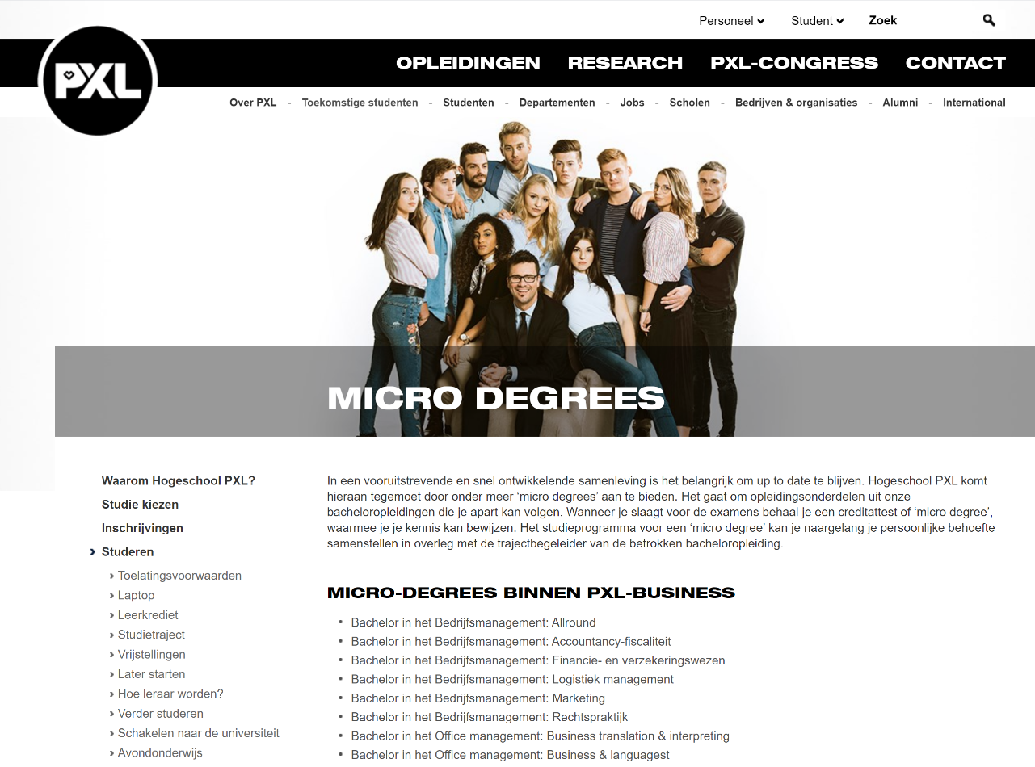
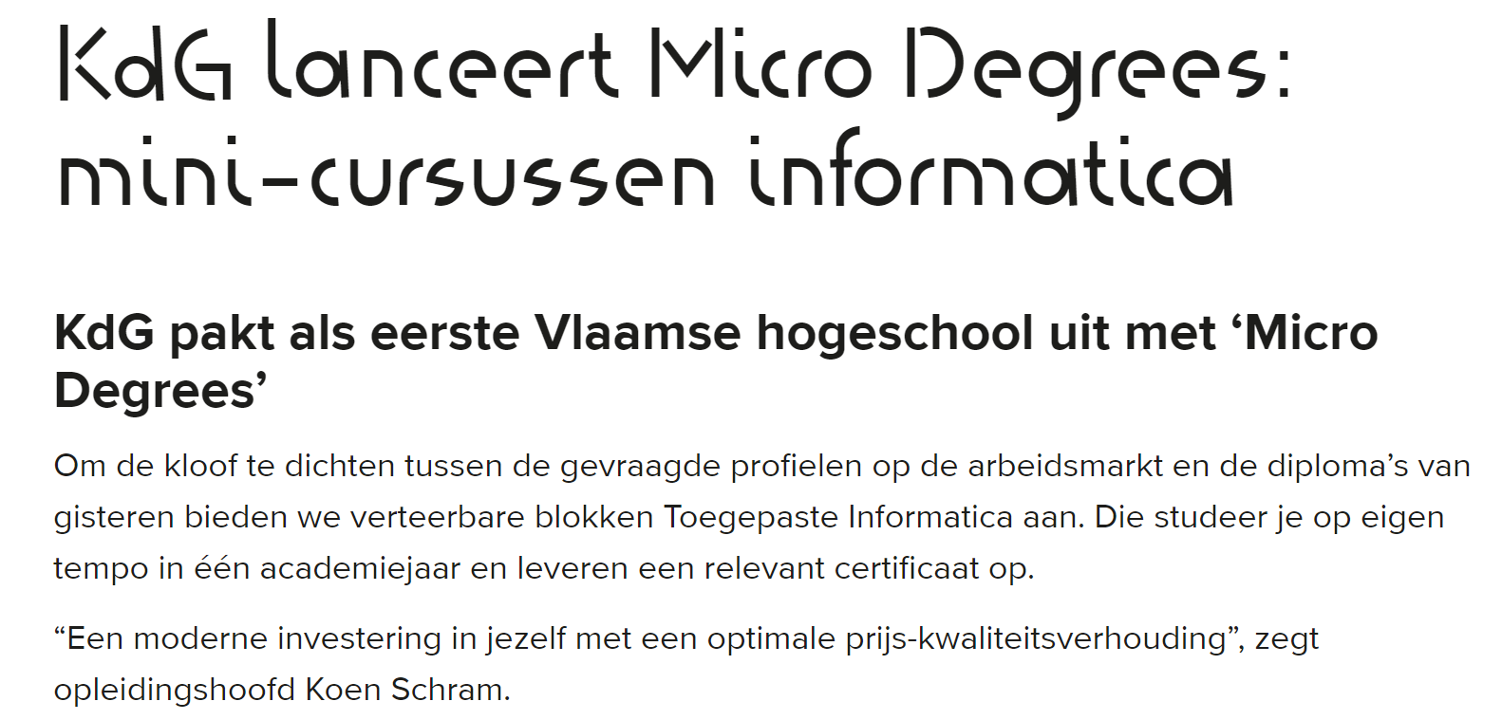

Slide 28
Example of HOGent

Slide 29
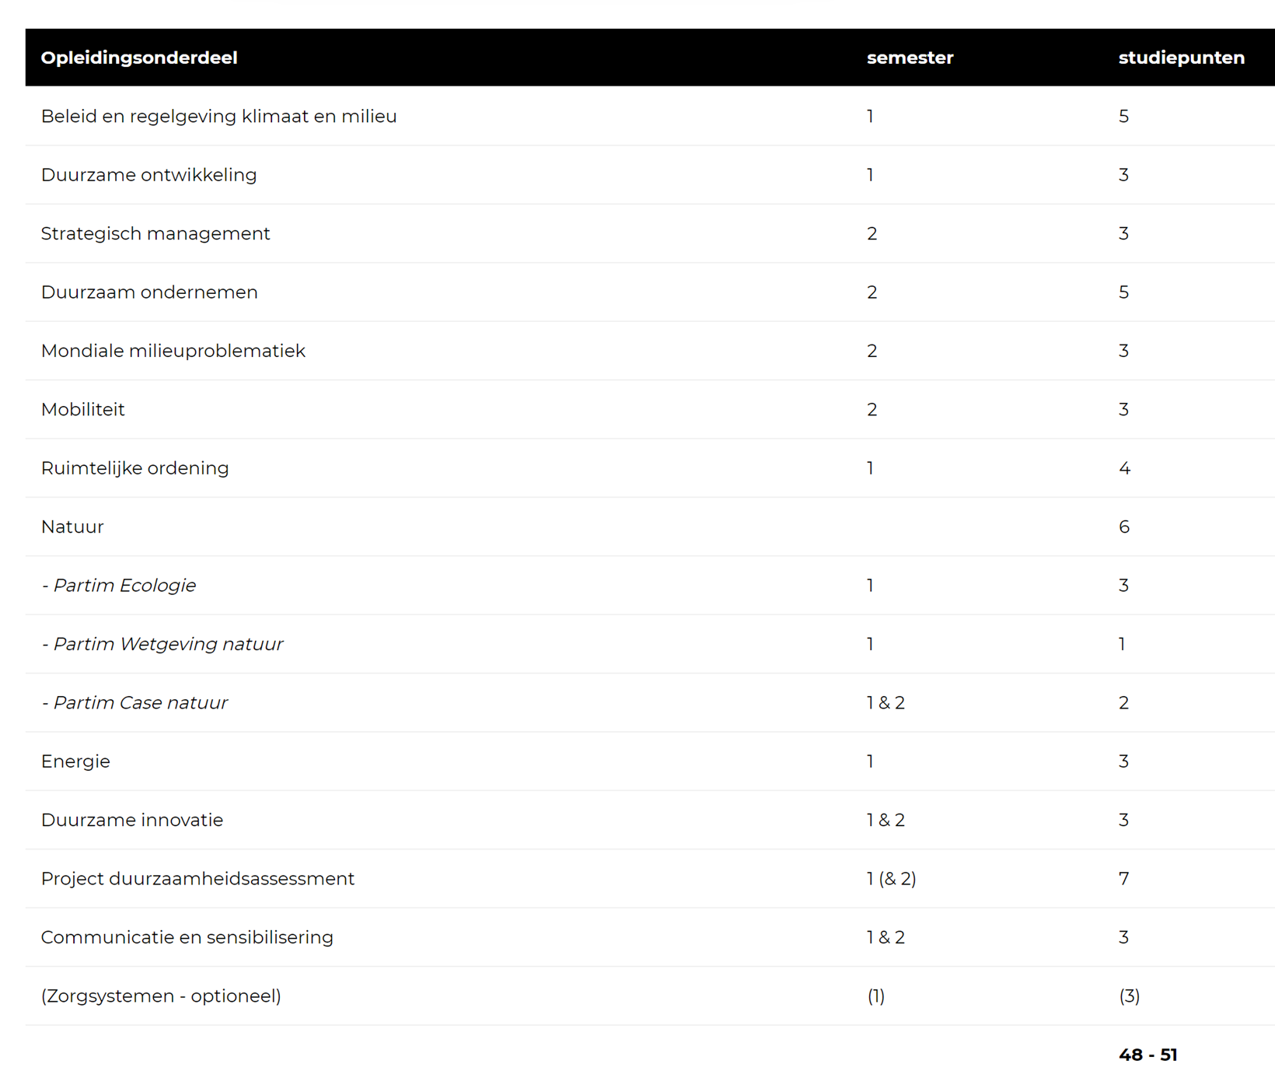
Example of HOGent

Slide 30
Possibilities of this legal framework
Create micro-degrees
Some HEIs are setting up a system to support and validate students’ societal engagement through:
“Certificates of Competency”
“Badges” (= an online standard to recognize and verify learning, e.g. Open badges, Badger,…)
Micro masters in European Universities
…

Slide 31
Advantages of such a legal framework
For different stakeholders
HEI’s: fits with exisiting practices e.g. ECTS, especially the concept of “credit transfer” (portability / stackability) as we know it from international student mobility
End users: increased ownership
Potential employers: increased trust

Slide 32
Advantages of such a legal framework
Opportunities to increase the potential use of the existing learning offer, encompassing all types of learning (related to HE), i.e. beyond lifelong learning, MOOCs etc.
Enhances flexibility (although this has its limits…)
Openness towards
more diverse learners - but also beneficial for ‘regular students’: working together with mature students, students from different backgrounds,
more diverse ways of learning (e.g. also non-formal, online)

Slide 33
Potential for the future
Investigate links with the European Student Card Initiative (= integration of Erasmus Without Paper, EMREX and the European Student Card → focus on student data portability) → give ownership of the microcredential to the end-user
Use the potential of all the attention for micro-credentials in European Universities

Slide 34
Contact
Magalie.Soenen@ond.vlaanderen.be
Flemish Government
DEPARTMENT EDUCATION & TRAINING
Division Higher Education and Adult Education

